Slide 1
Presentation on Artificial Intelligence Chatbot For HealthCare
Phase one project
BACHELOR OF TECHNOLOGY (CSE)
September 2020
COLLEGE OF COMPUTING SCIENCES AND INFORMATION TECHNOLOGY
TEERTHANKER MAHAVEER UNIVERSITY, MORADABAD
Project Guide:
Mr. Aaditya Jain
Ass. Professor
CCSIT, TMU
Submitted By:
Raushan Raj TCA1809060
Nameera Meraj TCA1911003
Arjun Sharma TCA809067

Slide 2
Project Description:
The visitor can perform the basic task.
Reply to its queries with a binary response (Yes/No).
Then the patient can see their problem on screen.
The best part is that it will provide the doctor’s information.
So that can easily find their doctor without face with any type of problem.
Then they can start their treatment.
With the help of Chatbot so that one can even check their problem at any time.
You have to just reply with the clicking of button (Yes or No).

Slide 3
Problem Statement:
Traditional method of getting appointment for doctor, standing in long queues for number of hours.
Doctors didn’t able to give more time to patients.
Patient want more consult regarding their health.
Consulting fees of the doctors.
Hours and Hours are wasted in waiting.

Slide 4
Scope of Work:
This project consists number of patients.
This work help visitor to get health related advice and suggests experts of their fields.
Provide maximum accuracy in result of health issues based on Symptom’s Based Query.
Chatbots have an ability to engage customers.
They can also foster a relationship between customer and brands, and deliver a more personalized experience.

Slide 5
Health chatbots on the rise:
In the last couple of years, we’ve had to bid farewell to some prominent health chatbots. Izzy, the handy period tracking and women’s health bot, stopped to exist. Eva, from Spain-based Bots4Health, who could chat about a wide range of health issues with users followed suit. Even some promising tech like Cognitoys with its dinosaur-shaped A.I. companion toys went off the radar. But just as we have to bid farewell to those bots who left us, we are happy to welcome new ones in this venture.
but health chatbots are on the rise and keep attracting investors. A Crunchbase analysis found that VCs have invested more than $800 million in at least 14 known startups that offer some version of a chatbot with health features.

Slide 6
Project Modules:
Problem Recognition: The Problem Recognition Module is responsible for understanding the visitor’s problem through basic Yes/No queries.
Evaluation and synthesis: This module evaluate the problem into different
segments and synthesis the collect data and feed into the module.
Modeling: This module is responsible for processing evaluated data and determine the issue occur in the data entry.
Result: After the model process the problem, this lead to the result of the problem recognized by the HealthCare Chatbot.
This module may represent the suggestion of the doctor or suggests the Doctors of the field.

Slide 7
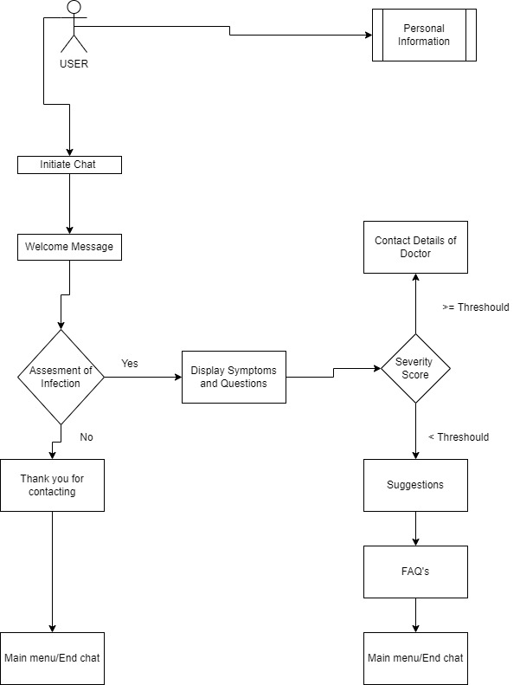
Implementation Methodology:

Slide 8
Technology Used:
Software Platform
a) Front-end: Tkinter, Jupyter Notebook, Python
b) Back-end: MySql.
Hardware Platform
4 GB RAM, 20 GB Hard Disk, OS windows 7+, Jupyter.

Slide 9
Advantages of the project:
24/7 Availability
Instant Response
Consistency in Answers
Omni-channel
Personalization
A reduction
Well-recorded

Slide 10
Why are chatbots important in healthcare?
According to research in 2019, the most valuable features of using chatbots in healthcare include:
Monitoring: awareness and tracking of user’s behavior, anxiety, weight changes, to encourage developing better habits.
Anonymity: especially in sensitive and mental health issues
Personalization: Level of personalization depends on the specific application. Some applications make use of measurements of
Physical vitals (oxygenation, heart rhythm, body temperature) via mobile sensors
Patient behavior via facial recognition
Real time interaction: immediate response, notifications, and reminders.
Scalability: ability to react with numerous users.

Slide 11
What are the top chatbot use cases in healthcare?
1. Provide medical information
Chatbot algorithms are trained on massive healthcare data including disease symptoms, diagnostics, markers, and available treatments. Public datasets are used to continuously train chatbots, such as COVIDx for COVID-19 diagnosis, and Wisconsin Breast Cancer Diagnosis (WBCD). Conversational chatbots with different intelligence levels can understand the questions of the user and provide answers based on pre-defined labels in the training data.
For example:
Healthily app provides information about different diseases’ symptoms, assessments of overall health, and tracks patient progress.
Ada app provided correct disease suggestions earlier than the time of clinical diagnosis 56% of the time (Wikipedia)
2. Schedule medical appointments
Chatbots are integrated into the medical facility system to extract information about suitable physicians, available slots, and clinics and pharmacy working days. Chatbots ask patients about their current health issue, find matching physician and dentists, provide available time slots, and schedule, reschedule, and delete appointments for patients. Chatbots are also integrated into user’s device calendars to send reminders and updates about medical appointments.

Slide 12
3. Collect patient data
Chatbots can extract patient information using simple questions about name, address, symptoms, current doctor, and insurance details. Chatbots then store this information in the medical facility system to facilitate patient admission, symptom tracking, doctor-patient communication, and medical record keeping.
4. Handle insurance inquiries
Chatbots can provide insurance services and healthcare resources to patients and plan members. Moreover, integrating RPA or other automation solutions with chatbots allows automating insurance claim processing and healthcare billing.
To read more on how RPA can automate insurance processes, feel free to read our article RPA in Insurance Industry: Use Cases & Case Studies [2021]
5. Provide mental health assistance
Chatbots that provide mental health assistance are trained to to deliver cognitive behavioral therapy (CBT) for patients with depression, post traumatic stress disorder (PTSD), and anxiety, or train autistic patients to improve their social skills and job interview skills. Users can interact with chatbots via text, microphones and cameras.
For example, Woebot, which we listed among successful chatbots, provides CBT, mindfulness, and Dialectical Behavior Therapy (CBT).
6. Request prescription refills
Chatbots collect patient information, name, birthday, contact information, current doctor, last visit to the clinic, and prescription information. The chatbot submits a request to the patient’s doctor for a final decision and contacts the patient when a refill is available.
This allows doctors to process prescription refills in batch or automate them in cases where doctor intervention is not necessary.

Slide 13
Future Scope of the project:
It will interact with users by using natural language.
Online shopping, online frequently asked questions (FAQ) and also assistant system.
Users can easily use it without background knowledge or experiences.
Serve many people at the same time with the same topic and without getting bored.
This may be the suitable capability to be adopted in public service such as the medical service.
Objective of this work is to increase the service capability and decrease the operation cost of medical consultant service by using the chatbot.

Slide 14
Conclusion of the project:
It determined that the modern chatbots perform at a very high standard to provide a reliable response to users compared to the traditional chatbots.
Unlike existing chatbots which focused on various domains of healthcare.
This is the best solution for people who are busy with their job schedules.
They do not need to wait in the queue for hours to get an appointment with a doctor every time instead they can chat with the bot.

Slide 15
References
https://www.uniphore.com
M Bates - IEEE pulse, 2019 - ieeexplore.ieee.org
htttps://journals.sagepub.com/doi/full/10.1177/0706743719828977
htttps://www.googleadservices.
www.virtualspirits.com
https://www.chatbot.com/chatbot-for-healthcare/
https://medicalfuturist.com/top-12-health-chatbots/
https://alan.app/blog/what-is-a-medical-chatbot/
www.chatbot.com/chatbot-for-healthcare/

Slide 16

Thank you!

